Slide 1



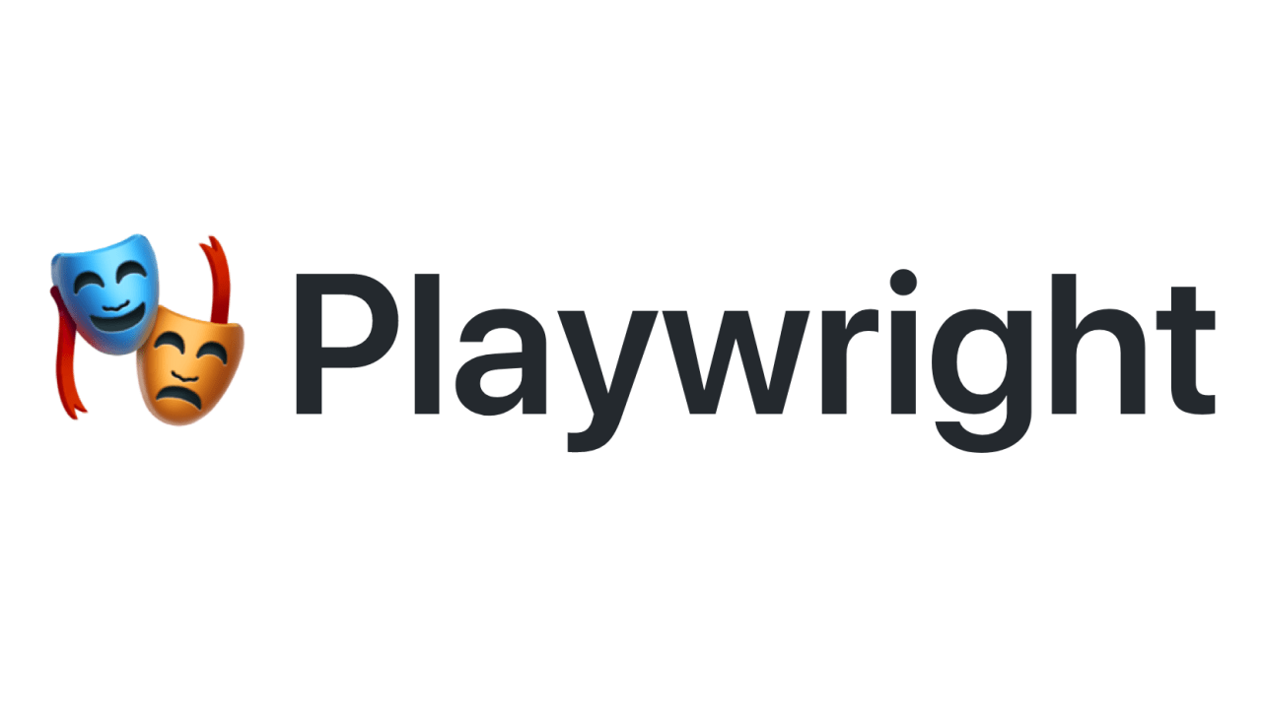
Learning PlayWright (Java)
E2E Web Testing with Playwright(Java)
Pramod Dutta
SDET Manager
API Testing with Playwright #2

Slide 2
Agenda
Learn How to perform the API Testing.
Basic CRUD using POSTMAN
CRUD using Playwright APIRequestContext.
GET Call
Post Call

Slide 3
Documentation Link
https://playwright.dev/java/docs/api-testing
https://www.npmjs.com/package/json-server
https://mvnrepository.com/artifact/com.google.code.gson/gson/2.9.0
https://gist.github.com/PramodDutta/a63c4cee3b773a1daad2e0533e75b7cc
https://playwright.dev/java/docs/api/class-apirequestcontext
https://gist.github.com/9764e02445aab8e402551c05cbdb79fa

Slide 4
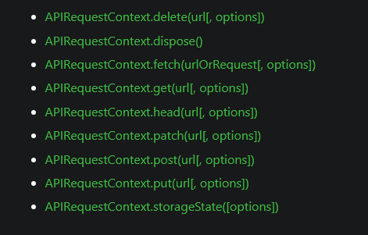
APIRequestContext
Each Playwright browser context has associated with it APIRequestContext instance which shares cookie storage with the browser context and can be accessed via BrowserContext.request() or Page.request().

Slide 5
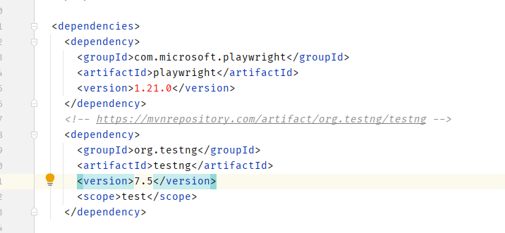
Create Project & Add dep.

Slide 6
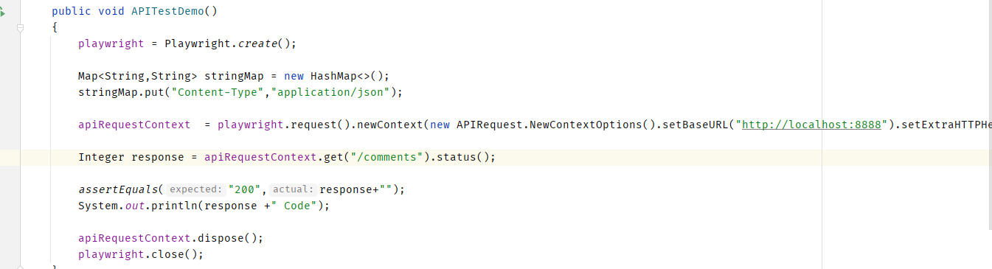
Create Project & Add dep.

Slide 7
Playwright Demo.

